Slide 1
A study on developing a hybrid recommender system for Telecommunication Industry in Sri Lanka
Chiran Hewawitharana IM/2016/046
Supervised By: Dr. Chathura Rajapaksha, Mr. Dinesh Asanka

Slide 2
Content
Background of the research
Research problem
Scope of the research
Literature review
Proposed solution
Proposed methodology
Progress so far

Slide 3

Research Problem

Slide 4
Background of the Research
The Telecommunication Industry has become the center for digital growth in Sri Lanka.
10.9 million (34 per 100 people) internet users and 30.41 million mobile connections (1499 per 1000 people), equivalent to 141.7% of the total population [Central Bank, 2020]
Recommender Systems are quiet popular and enhancing the business profits in Retail industries, but no much related work found in Telecommunication Industry in Sri Lankan context.
Telecommunication data are highly asynchronous and significantly different compared to retail and other industries.

Slide 5
Research Problem
Due to high availability of telecom service providers and service packages, subscriber churn has increased.
Some services may pass unobserved. If they were recommended when needed, subscriber may continue with the career.
Loyal subscribers need to be identified and rewarded with cross-selling and up-selling offers.
A traditional user-interaction based recommender system won't be sufficient to to address this dynamic market and high competition in telecommunication industry,
Issues with Collaborative Filtering approach in a dynamic context (cold-start problem etc.)
User-service interactions, and demographics content alone won’t give accurate recommendations.
Awareness of Context (Contextual pre-filtering approach) is critical.

Slide 6
Research Problem
Recommendation need to be offered to the more beneficial subscriber groups.
Subscriber segmentation, identifying and prioritizing target subscriber groups, is crucial for enhancing the business value of recommendations offered.

Slide 7

Research Problem : Scope
Artificial Intelligence
DL - Neural Networks NLP Text Mining
Local & IDD Voice Calls BroadBand Cable TV
Hybrid Recommender (CF + CBF)
Context- aware
Telecom Industry
Recommender Systems

Slide 8
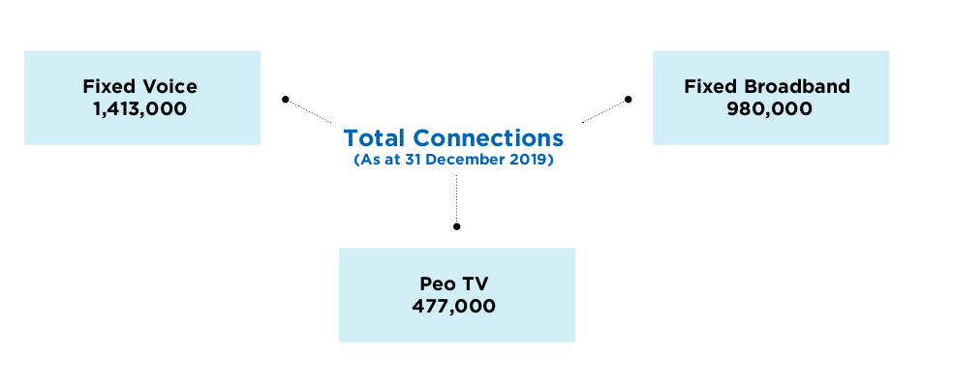
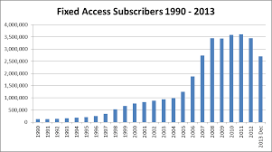
Research Problem : Justification
Due to high competition, and the huge variety of services available in telecommunication industry, a requirement has arised from service providers to implement a recommender system to recommend services to its beneficial subscribers to reduce subscriber churn and gain profits.
There is a dearth of studies done in Sri Lanka in particular telecom sector to implement a recommender system.
Acquiring new customers has become multiple times more expensive than retaining a customer. [Chen C., 2016]
According to [Soft et. al., 2017], as telecommunication services continuously providing different choices to the end user, leading some services to pass unobserved even if useful.
This study fills two gaps (practise gap and empirical gap)

Slide 9
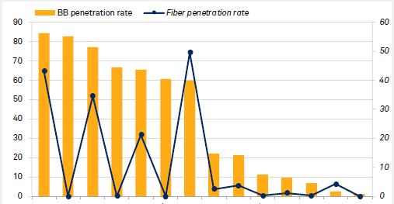
Literature Review

Slide 10
01. Recommender System - theories and applications
Reference | Related findings and suggestions
[Seyednezhad et. al., 2018] A Review on Recommendation Systems: Context-aware to Social-based. | Main four methods: Demographic filtering, content-based filtering, collaborative filtering and hybrid methods CF: Methods of extracting user interactions for a recommendation: Explicit/ Implicit CBF: make recommendations based on the description of the items. Three parts: content analyzer, profile learner and filtering component. CBF techniques: Keyword based vector space model CF techniques: Cosine similarities, KNN - Neighbourhood approach, latent factor model, Challenges: cold-start problem, multi armed bandit

Slide 11
01. Recommender System - theories and applications
Reference | Related findings and suggestions
[Yousef et. al., 2018] A genetic algorithms-based hybrid recommender system of matrix factorization and neighborhood-based techniques, [Aggarwal CC, 2016] Ensemble-based and hybrid recommender systems. | Hybrid recommenders: Combination of CF, CBF and Contextual information. Memory based recommenders: Use of User-item rating matrix, depend on past data. Model based recommenders: generates a model that learns from the information of user-item ratings and recommends new items. Hybrid approach: Either CBF-> multi-level CF or CF -> multiclass CBF (user ratings are used as a user feature) Evaluation methods: Quality of predication validated by MAE (Mean Absolute error), RSME (Root Mean square error) and coverage

Slide 12
02. Recommender Systems in Telecommunication Industry
Reference | Related findings and suggestions
[Soft et. al., 2017] Recommender System for Telecommunication Industries: A Case of Zambia Telecoms. | Importance of recommendation: lose their revenues because of customers switching from one provider to another in search of cheap affordable high-quality products and services. Lack of a proper understanding of the both current and future(predictive) customer base, and their(predictive) requirements lead to customer churn and revenue lost. Context features (independent variables) identified: User activity context, time, location, demographics socio-economic factors, payment patterns, User-item correlation, User satisfaction/opinions (Likert scale) having a reduced set of items is more important that having one item recommended.

Slide 13
02. Recommender Systems in Telecommunication Industry
Reference | Related findings and suggestions
[Yu,Jian et. al., 2011] A Recommender System for Telecom Users: Experimental Evaluation of Recommendation Algorithms | Suggested approach: to collect new customer information, gather similar existing customer data (purchase records, usage history) and to collect replated product data. The main characteristics of telcom data is here there could be millions of users and relatively few services. Unlike enterprise applications which are usually invoked synchronously, telecom applications are always invoked asynchronously. Proposed algorithms: Generic user/ item based/ item-user/ slope one ItemAverageRecommender: except that estimated preferences are adjusted for the Users' average preference value. TreeClustering approach

Slide 14
03. Telecom Big Data Analytics
Reference | Related findings and suggestions
[Bursha et. al., 2019] An Intelligent Data Analysis for Recommendation Systems Using Machine Learning [Chen C., 2016] Use cases and challenges in telecom big data analytics. | With the advancement and of big data technologies, operators are now able to collect more nearly complete data about a user’s experience and behavior. Challenges: capabilities of uncovering insights from large Volume of datasets, Velocity and Veracity. Telcom framework contains three horizontal layers – resource, service, and customer, spanning across two vertical perspectives – infrastructure & ‘product and operations’. The telecom data may include, user locations, CRM and call center logs, usage, network performance, subscriber plans, and demography, which may associated with a set of service KPIs (S-KPIs)

Slide 15
04. Context-awareness for recommender systems
Reference | Related findings and suggestions
[Adomavicius et. al., 2011] Context-Aware Recommender Systems | Context adds an additional another dimension to the user-item data model of recommender system and can be utilized in different ways during CBF or CF processes. Representational and interactional context. Contextual factors to consider: Time context, location, purchasing purpose, factors influencing buying decision etc. Knowledge of contextual factors in a recommender system: full or partially observable, unobservable. Contextual pre-filtering: Context is derived and used prior to the modeling to select the suitable 2D recommender (user x context x rating) Exact context can be too wide or narrow.

Slide 16
04. Context-awareness for recommender systems
Reference | Related findings and suggestions
[Sundermann et. al., 2019] Using Opinion Mining in Context-Aware Recommender Systems [Bahramian et. al., 2017] A Cold Start Context-Aware Recommender System for Tour Planning Using Artificial Neural Network and Case Based Reasoning | Context: Physical context, social context, interaction media context and model context. There are increasing efforts to incorporate the rich information embedded in user’s reviews/texts into the recommender systems. Challenges: difficulty in the acquisition of contextual information. There is a lack of automatic methods for extracting this type of information. User opinions: overall opinions, aspect opinions Interest of a user on an item is usually measured by a rating which can be obtained either explicitly or implicitly: Numeric, Ordinal, Binary, Unary.

Slide 17
05. Deep Learning Recommender Systems
Reference | Related findings and suggestions
[Covington et. al., 2016] Deep Neural Networks for YouTube Recommendations. [Xiangnan et. at., 2017] Neural Collaborative Filtering | Embedded features to an extended matrix factorization model, which answers the cold-start problem in collaborative filtering, with more precise and accurate recommendations. Introducing Neural Collaborative Filtering. Consideration of data: variety, freshness, and noise Suggest hybrid recommender model with two deep learning models, extended matrix factorization model (with user context as an additional inputs) for Collaborative filtering called as “candidate generation”. It returns a shortlisted set of recommendations which then filtered out by Content based recommender model to derive the final set of personalized recommendations.

Slide 18
Research Purpose
The purpose of the research is to implement a hybrid-recommender system, which is aware to the user content, interactions and other contextual factors, and able to provide accurate recommendations for subscribers.
Research Approach: Mixed approach (Qualitative, Quantitative)

Slide 19

Proposed Solution

Slide 20
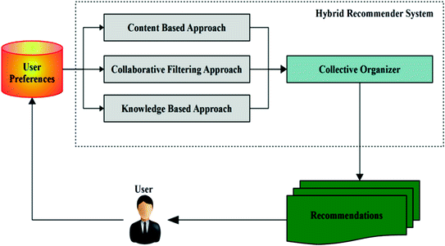
Proposed Solution
Developing a context-aware hybrid recommender system to recommend telecommunication services (Voice/ Broadband Internet/ Cable TV) to identified subscriber segments, targeting cross-selling and up-selling.
Creating subscriber profiles (ex: based on services subscribed, their usage, user demographics, payment pattern, user opinion) as accurate as possible, cluster them and find appropriate relationships to provide next best recommendation.

Slide 21
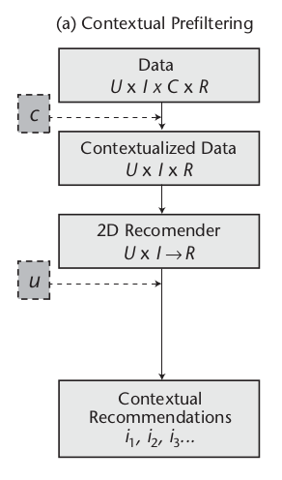
Proposed Solution
Why Context is important?
Telecommunication services data and user behaviours are dynamic and asynchronous.
Considering the User-Service interactions, demographic content won’t be enough for accurate predictions.
Contextual pre-filtering:
Contextual features, taken as inputs to the model at the time of training. [Adomavicius et. al., 2011]
Context considered:
Business rules
Derived user context (demographics, preference, socio-economic factors etc.)
Timeframes/ Locations
User reviews and opinions on services (Fault logs/ complaints/ inquiries)
Billing and payment patterns
Extra service usage (Extra GB, channels and voice minutes)
U - User data C - Context
I - Interactions R - recommendation

Slide 22
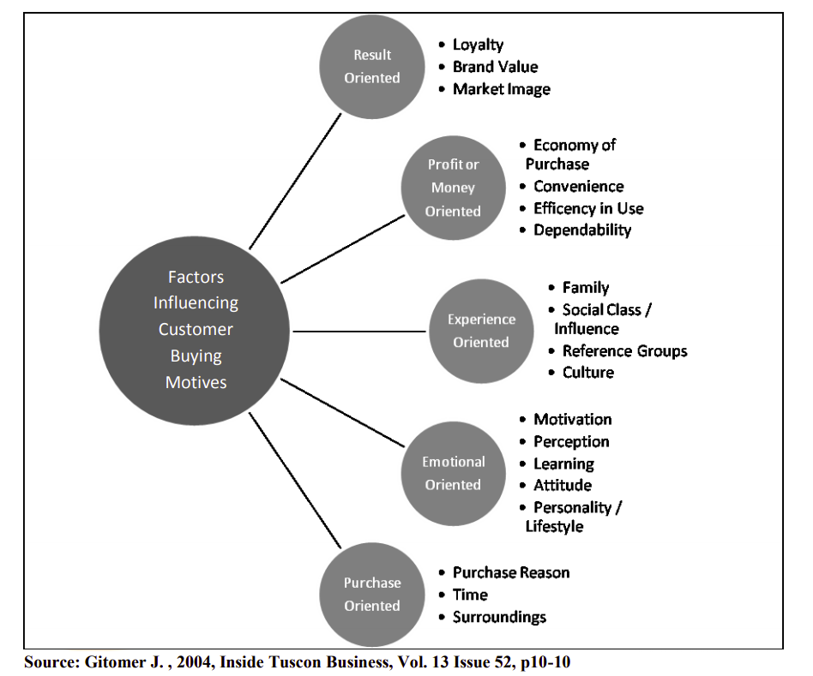

Slide 23
Proposed Methodology
A systematic review of literature will be conducted on building a recommender system for telecommunication Industry.
Stage 1
Stage 2
Stage 3
Stage 4
Data Collection
Data Analysis and Feature Engineering
Development of predictive recommender models
Testing, Validation and Integration as an end- user service
Structured Data
* Service Usage: Ratings * User demographics * conducting a survey * Billing/ payment history
* services subscribed
Unstructured Data
* CRM logs - inquiries/complaints * Other user reviews
Extracting User Profile features
Developing service package catalog
Analysis of unstructured text data using text mining, NLP
Extracting contextual information for pre-filtering
Comparing available recommender techniques
Developing hybrid recommender model(s)
Testing and validating the accuracy of predicted results
Integrating predicted results to a web-based system to be consumed by end-users

Slide 24
Proposed Methodology cont’d.
Data Gathering
Data pre-processing
User Demographic content (U)
Usage Ratings (I)
Structured
Ex: Usage and demographics data
Unstructured
Ex: reviews/ CRM logs
Text Mining
NLP
Feature Engineering
Telcom Services/ Packages
Contextual features (C)
Subscriber Segmentation
profiles with contextual features
cross-selling
Clustering (Uplift Modeling)
Hybrid Recommender system CF -> CBF ( +Context(C) )
Recommend Services/ Packages
Identifying and prioritizing subscriber segments for recommendations
up-selling
Recommend Similar Users’ content

Slide 25
Proposed Methodology cont’d.
Hybrid Recommender system (ANN)
User & Services content
Segmented subscriber groups
Users (U)
CF Model
( U x I -> R )
Selected set of recommendations
CBF Model
Interactions (I)
Context (C)
Personalized Recommendations
Similar Users
cross-selling
up-selling

Slide 26
Proposed Solution : Approach
Solution Approach:
Deductive : Aims to prove existing theories within formulated hypothesis
Predictive: Provide predicted recommendations on past context
Proposed Technologies:
Data pre-processing : Python, Pandas, SQL
Descriptive analysis: Pandas, numpy, seaborn, matplotlib, plotty
Text mining and feature extraction: NLP using Python, NLTK, (Gensim, spaCy)
Predicting recommendations: Deep-Learning- ANN using Python, Tensorflow, Keras
Uplift Modeling - Python pylift

Slide 27
Progress so far : SLT Project
Descriptive analysis on service usage datasets (VOICE/BB/PEO TV)
Analysis on ”Product State Changes” dataset
Building user profile (usage ranks, user location, and interested packages)
To Do:
Complete user profile up to best accurate level
Services/ Packages catalog
Gather and extract contextual data (including opinion mining)
Implementation of feasible recommender models

Slide 28

Demonstration

Slide 29
References
[Seyednezhad et. al, 2018] Seyednezhad, s. M. Mahdi & Cozart, Kailey & Bowllan, John & Smith, Anthony. (2018). A Review on Recommendation Systems: Context-aware to Social-based.
[Bursha et. al., 2019] Bushra Ramzan, Imran Sarwar Bajwa, Noreen Jamil, Riaz Ul Amin, Shabana Ramzan, Farhan Mirza, Nadeem Sarwar, "An Intelligent Data Analysis for Recommendation Systems Using Machine Learning", Scientific Programming, vol. 2019, Article ID 5941096, 20, 2019.
[Chen C., 2016] Chen, C. (2016). Use cases and challenges in telecom big data analytics. APSIPA Transactions on Signal and Information Processing, 5, E19, 2016.
[Ivens et.al., 2018] Ivens Portugal, Paulo Alencar, and Donald Cowan. The use of machine learning algorithms in recommender systems: A systematic review. ExpertSystems with Applications 97 (2018), 205–227, 2018.
[Soft et. al., 2017] Soft, M., Zulu, D., & Mazhandu, R. Recommender System for Telecommunication Industries: A Case of Zambia Telecoms. American Journal of Economics, 7, 271-273, 2017.

Slide 30
References
[Ahmed et. al., 2019] Ahmed, A.A.Q., Maheswari, D. An enhanced ensemble classifier for telecom churn prediction using cost based uplift modelling. Int. j. inf. tecnol. 11, 381–391, 2019.
[Yousef et. al., 2018] Yousef Kilani, Ahmed Fawzi Otoom, Ayoub Alsarhan, Manal Almaayah, A genetic algorithms-based hybrid recommender system of matrix factorization and neighborhood-based techniques, Journal of Computational Science, Volume 28, Pages 78-93, ISSN 1877-7503, 2018.
[Aggarwal CC, 2016] Aggarwal CC (2016) Ensemble-based and hybrid recommender systems. In: Recommender systems, Springer International Publishing Switzerland, pp 199–224, 2016
[Sundermann et. al., 2019] Sundermann, C.; Domingues, M.; Sinoara, R.; Marcacini, R.; Rezende, S. Using Opinion Mining in Context-Aware Recommender Systems: A Systematic Review.Information 2019, 10, 42, 2019.

Slide 31
References
[Adomavicius et. al., 2011] Adomavicius, G., Mobasher, B., Ricci, F., & Tuzhilin, A. (2011). Context-Aware Recommender Systems. AI Magazine, 32(3), 67-80.
[Yu,Jian et. al., 2011] Yu, Jian & Falcarin, Paolo & Vetro, Antonio. (2011). A Recommender System for Telecom Users: Experimental Evaluation of Recommendation Algorithms. Proceedings of 2011, 10th IEEE International Conference on Cybernetic Intelligent Systems, CIS 2011. 81-85. 10.1109/CIS.2011.6169139.
[Bahramian et. al., 2017] Bahramian, Zahra & Abbaspour, Rahim & Claramunt, Christophe. (2017). A Cold Start Context-Aware Recommender System for Tour Planning Using Artificial Neural Network and Case Based Reasoning. Mobile Information Systems. 2017. 1-18. 10.1155/2017/9364903.
[Covington et. al., 2016] Covington, Paul, J. Adams and Emre Sargin. “Deep Neural Networks for YouTube Recommendations.” Proceedings of the 10th ACM Conference on Recommender Systems (2016): n. Pag.
[Xiangnan et. at., 2017] He, Xiangnan & Liao, Lizi & Zhang, Hanwang. (2017). Neural Collaborative Filtering. Proceedings of the 26th International Conference on World Wide Web.

Slide 32
Thank You

